Slide 1
Graph Theory Using Adjacency Lists
www.Stats-Lab.com
Twitter: @StatsLabDublin

Slide 2
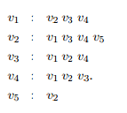
Let G be a simple graph with vertex set
V (G) = {v1, v2, v3, v4, v5}
and adjacency lists as follows:

Slide 3
Using Adjacency Lists
List the degree sequence of G.
Draw the graph of G.

Slide 4
Set Theory Rules of Inclusion : Example
www.Stats-Lab.com
Twitter: @StatsLabDublin

Slide 6
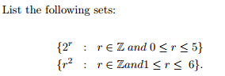
Rules of Inclusion

Slide 7
Rules of Inclusion

Slide 8
Set Theory Venn Diagrams
www.Stats-Lab.com
Twitter: @StatsLabDublin

Slide 9
Venn Diagrams
Suppose we have a labelled Venn diagram depicting A, B, C in such a way that they divide the universal set U into 8 disjoint regions.
The subset Y ⊆ U is deﬁned as Y = A ∪ (C − B).
Sketch the region Y on the Venn Diagram (shade in the appropriate regions).
Construct a membership table for Y.

Slide 10
Venn Diagrams
Y = A ∪ (C − B).

Slide 11
Venn Diagrams
A | B | C | Y
0 | 0 | 0
0 | 0 | 1
0 | 1 | 0
0 | 1 | 1
1 | 0 | 0
1 | 0 | 1
1 | 1 | 0
1 | 1 | 1

Slide 12
Venn Diagrams
A | B | C | Y
0 | 0 | 0 | 0
0 | 0 | 1 | 1
0 | 1 | 0 | 0
0 | 1 | 1 | 0
1 | 0 | 0 | 1
1 | 0 | 1 | 1
1 | 1 | 0 | 1
1 | 1 | 1 | 1

Slide 13
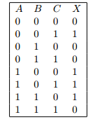
Venn Diagrams
Suppose we have a labelled Venn diagram depicting A, B, C in such a way that they divide the universal set U into 8 disjoint regions.
The subset X ⊆ U is deﬁned by the following membership table:

Slide 14
Venn Diagrams
Shade the region X on your diagram.

